Slide 1


Slide 2

#LifeKoKaroLift
SGC Coaching:
Articulate your Journey | Activate Your Vigour| Accelerate Mutual Growth
Session 16
CNN

Slide 3
Agenda
Quick Recap – (15 min)
Focused Teaching (60 min)
Doubts Resolutions (15 min)
Convolution Neural Network
doubts resolutions
Last 2 weeks

Slide 4
Recap: What the learner have learnt in the week
Quick Glance at Key Learnings
Neural Network
Forward Propagation
Backward Propagation
Basics
When to use
What is
When to use
What is
Basic Understanding

Slide 5
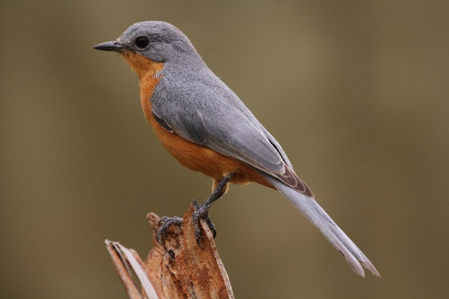
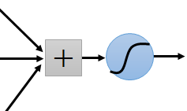
Consider learning an image:
Some patterns are much smaller than the whole image
Can represent a small region with fewer parameters
“beak” detector

Slide 6
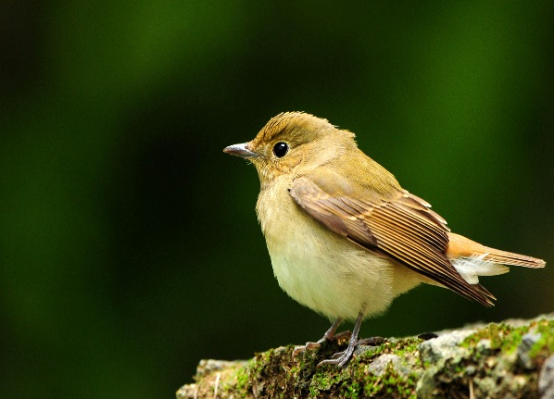
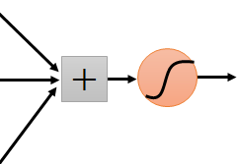
Same pattern appears in different places: They can be compressed! What about training a lot of such “small” detectors and each detector must “move around”.
“upper-left beak” detector
They can be compressed
to the same parameters.
“middle beak” detector

Slide 7
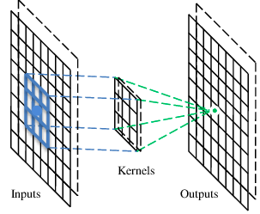
A convolutional layer
A CNN is a neural network with some convolutional layers (and some other layers). A convolutional layer has a number of filters that does convolutional operation.
Beak detector
A filter

Slide 8
Convolution
These are the network parameters to be learned.
1 | -1 | -1
-1 | 1 | -1
-1 | -1 | 1
1 | 0 | 0 | 0 | 0 | 1
0 | 1 | 0 | 0 | 1 | 0
0 | 0 | 1 | 1 | 0 | 0
1 | 0 | 0 | 0 | 1 | 0
0 | 1 | 0 | 0 | 1 | 0
0 | 0 | 1 | 0 | 1 | 0
Filter 1
-1 | 1 | -1
-1 | 1 | -1
-1 | 1 | -1
Filter 2
……
6 x 6 image
Each filter detects a small pattern (3 x 3).

Slide 9
Convolution
1 | -1 | -1
-1 | 1 | -1
-1 | -1 | 1
Filter 1
stride=1
1 | 0 | 0 | 0 | 0 | 1
0 | 1 | 0 | 0 | 1 | 0
0 | 0 | 1 | 1 | 0 | 0
1 | 0 | 0 | 0 | 1 | 0
0 | 1 | 0 | 0 | 1 | 0
0 | 0 | 1 | 0 | 1 | 0
Dot
product
3
-1
6 x 6 image

Slide 10
Convolution
1 | -1 | -1
-1 | 1 | -1
-1 | -1 | 1
Filter 1
stride=1
1 | 0 | 0 | 0 | 0 | 1
0 | 1 | 0 | 0 | 1 | 0
0 | 0 | 1 | 1 | 0 | 0
1 | 0 | 0 | 0 | 1 | 0
0 | 1 | 0 | 0 | 1 | 0
0 | 0 | 1 | 0 | 1 | 0
3
-1
-3
-1
-3
1
0
-3
-3
-3
0
1
3
-2
-2
-1
6 x 6 image

Slide 11
Convolution
Filter 2
-1 | 1 | -1
-1 | 1 | -1
-1 | 1 | -1
stride=1
Repeat this for each filter
1 | 0 | 0 | 0 | 0 | 1
0 | 1 | 0 | 0 | 1 | 0
0 | 0 | 1 | 1 | 0 | 0
1 | 0 | 0 | 0 | 1 | 0
0 | 1 | 0 | 0 | 1 | 0
0 | 0 | 1 | 0 | 1 | 0
3
-1
-3
-1
-1
-1
-1
-1
-3
1
0
-3
-1
-1
-2
1
Feature
Map
-3
-3
0
1
-1
-1
-2
1
3
-2
-2
-1
6 x 6 image
-1
0
-4
3
Two 4 x 4 images
Forming 2 x 4 x 4 matrix

Slide 12
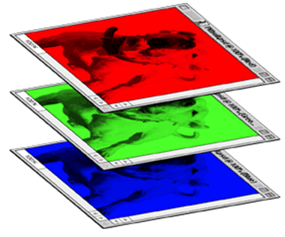
Color image: RGB 3 channels
1 | -1 | -1
-1 | 1 | -1
-1 | -1 | 1
-1 | 1 | -1
-1 | 1 | -1
-1 | 1 | -1
1 | -1 | -1
-1 | 1 | -1
-1 | -1 | 1
-1 | 1 | -1
-1 | 1 | -1
-1 | 1 | -1
1 | -1 | -1
-1 | 1 | -1
-1 | -1 | 1
-1 | 1 | -1
-1 | 1 | -1
-1 | 1 | -1
Filter 1
Filter 2
Color image
1 | 0 | 0 | 0 | 0 | 1
0 | 1 | 0 | 0 | 1 | 0
0 | 0 | 1 | 1 | 0 | 0
1 | 0 | 0 | 0 | 1 | 0
0 | 1 | 0 | 0 | 1 | 0
0 | 0 | 1 | 0 | 1 | 0
1 | 0 | 0 | 0 | 0 | 1
0 | 1 | 0 | 0 | 1 | 0
0 | 0 | 1 | 1 | 0 | 0
1 | 0 | 0 | 0 | 1 | 0
0 | 1 | 0 | 0 | 1 | 0
0 | 0 | 1 | 0 | 1 | 0
1 | 0 | 0 | 0 | 0 | 1
0 | 1 | 0 | 0 | 1 | 0
0 | 0 | 1 | 1 | 0 | 0
1 | 0 | 0 | 0 | 1 | 0
0 | 1 | 0 | 0 | 1 | 0
0 | 0 | 1 | 0 | 1 | 0

Slide 13
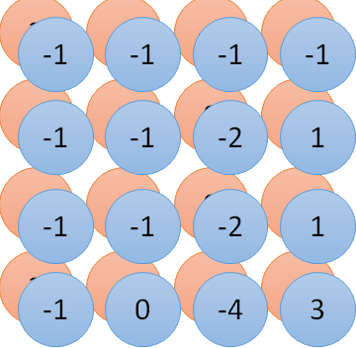
Convolution v.s. Fully Connected
1 | 0 | 0 | 0 | 0 | 1
0 | 1 | 0 | 0 | 1 | 0
0 | 0 | 1 | 1 | 0 | 0
1 | 0 | 0 | 0 | 1 | 0
0 | 1 | 0 | 0 | 1 | 0
0 | 0 | 1 | 0 | 1 | 0
1 | -1 | -1
-1 | 1 | -1
-1 | -1 | 1
-1 | 1 | -1
-1 | 1 | -1
-1 | 1 | -1
convolution
image
1 | 0 | 0 | 0 | 0 | 1
0 | 1 | 0 | 0 | 1 | 0
0 | 0 | 1 | 1 | 0 | 0
1 | 0 | 0 | 0 | 1 | 0
0 | 1 | 0 | 0 | 1 | 0
0 | 0 | 1 | 0 | 1 | 0
Fully-connected
……
……

Slide 14
Max Pooling
1 | -1 | -1
-1 | 1 | -1
-1 | -1 | 1
-1 | 1 | -1
-1 | 1 | -1
-1 | 1 | -1
Filter 1
Filter 2
3
-1
-3
-1
-1
-1
-1
-1
-3
1
0
-3
-1
-1
-2
1
-3
-3
0
1
-1
-1
-2
1
3
-2
-2
-1
-1
0
-4
3

Slide 15
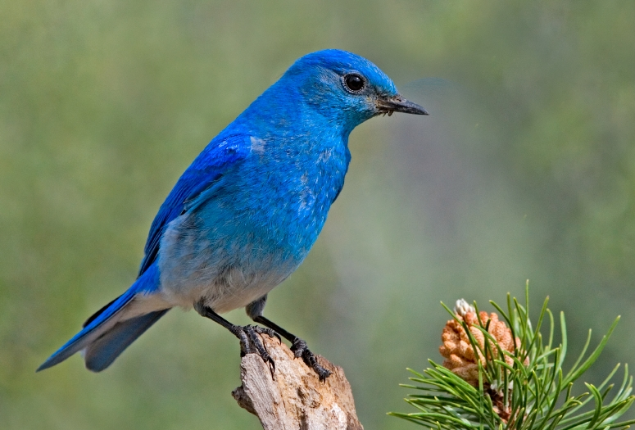

Why Pooling
Subsampling pixels will not change the object
bird
bird
Subsampling
We can subsample the pixels to make image smaller
fewer parameters to characterize the image

Slide 16
A CNN compresses a fully connected network in two ways:
Reducing number of connections
Shared weights on the edges
Max pooling further reduces the complexity

Slide 17
Max Pooling
New image
but smaller
1 | 0 | 0 | 0 | 0 | 1
0 | 1 | 0 | 0 | 1 | 0
0 | 0 | 1 | 1 | 0 | 0
1 | 0 | 0 | 0 | 1 | 0
0 | 1 | 0 | 0 | 1 | 0
0 | 0 | 1 | 0 | 1 | 0
Conv
3
0
-1
1
Max
Pooling
3
1
0
3
2 x 2 image
6 x 6 image
Each filter
is a channel

Slide 18
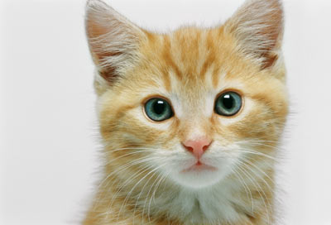
The whole CNN
3
0
-1
1
Convolution
3
1
0
3
Max Pooling
Can repeat many times
A new image
Convolution
Smaller than the original image
The number of channels is the number of filters
Max Pooling

Slide 19
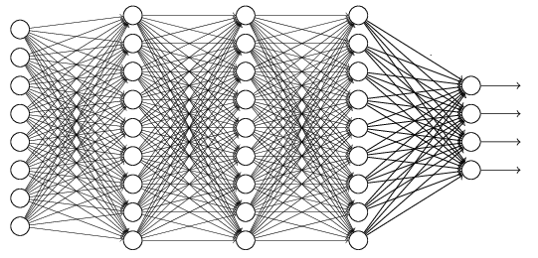
The whole CNN
cat dog ……
Convolution
Max Pooling
Fully Connected Feedforward network
A new image
Convolution
Max Pooling
Flattened
A new image

Slide 20
Flattening
3
0
1
3
0
-1
1
3
3
1
-1
0
3
Flattened
1
Fully Connected Feedforward network
0
3

Slide 21
The whole CNN
cat dog ……
Convolution
Max Pooling
Can repeat many times
Fully Connected Feedforward network
Convolution
Max Pooling
Flattened

Slide 22
Coding Time
Coding Time

Slide 23

Doubts Resolutions

